Slide 1


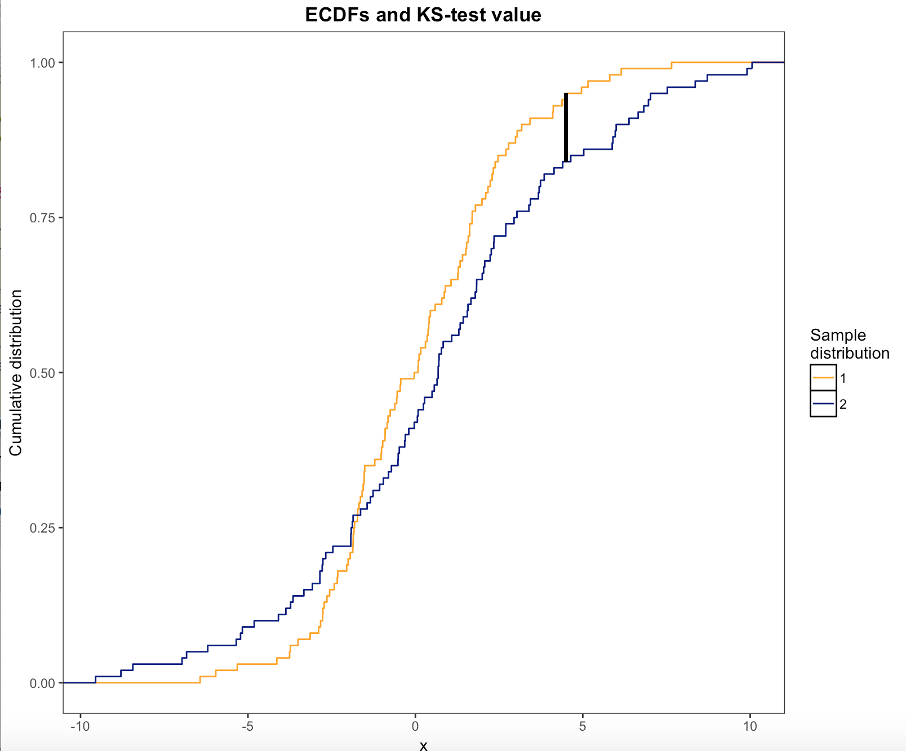
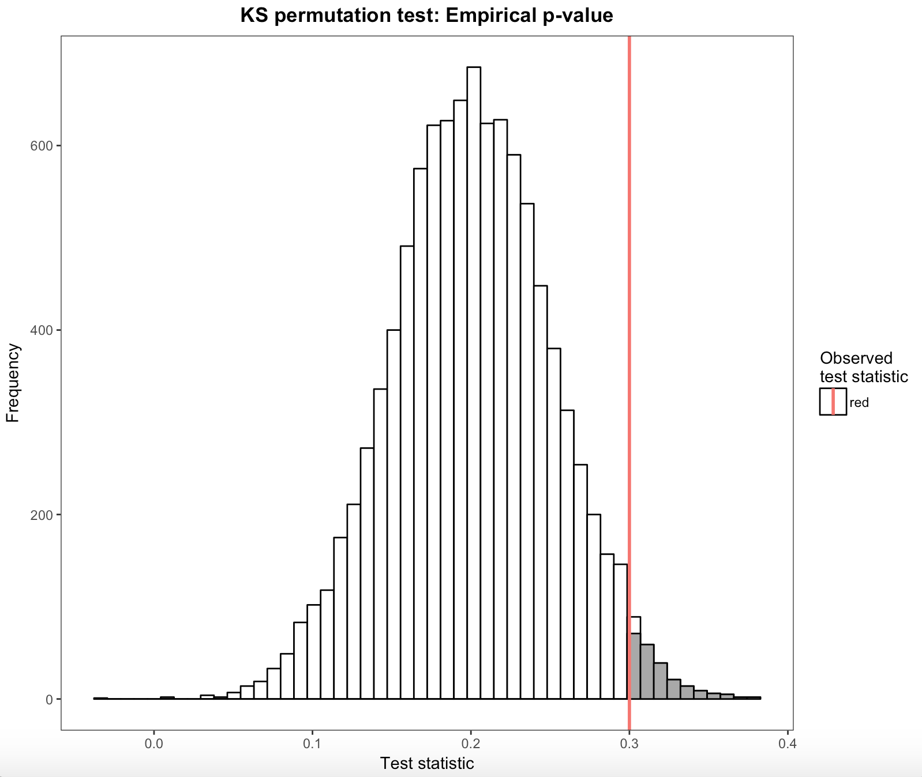
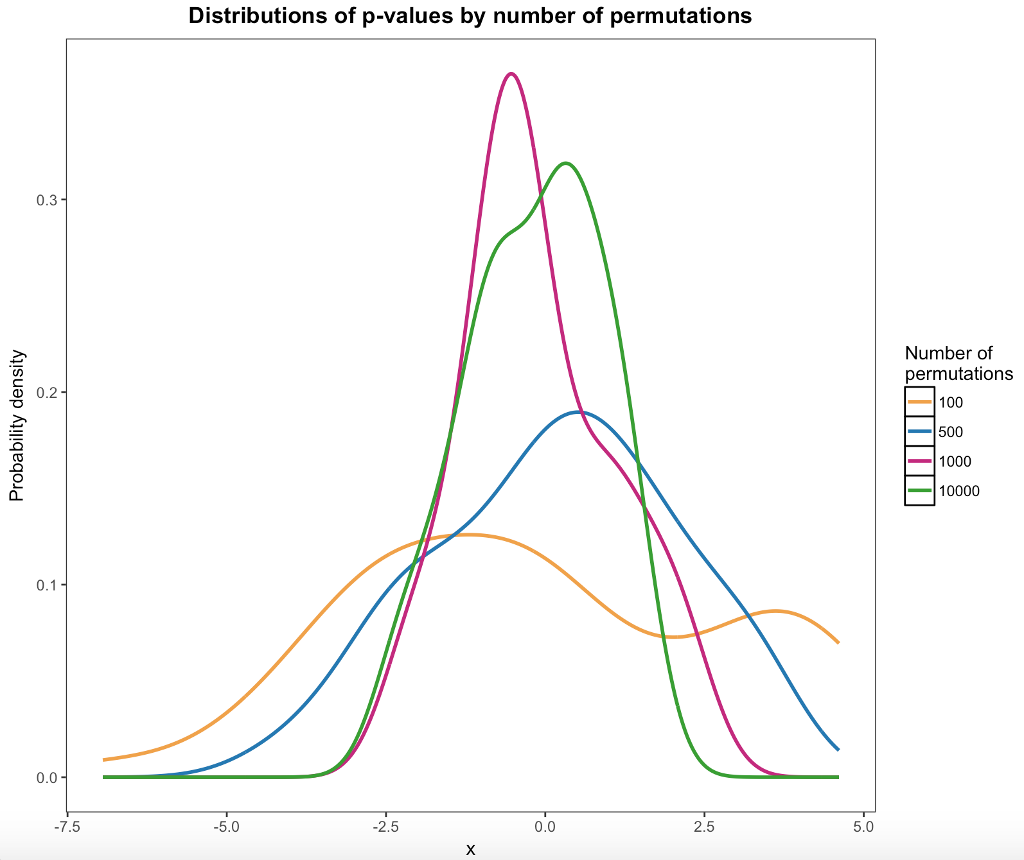
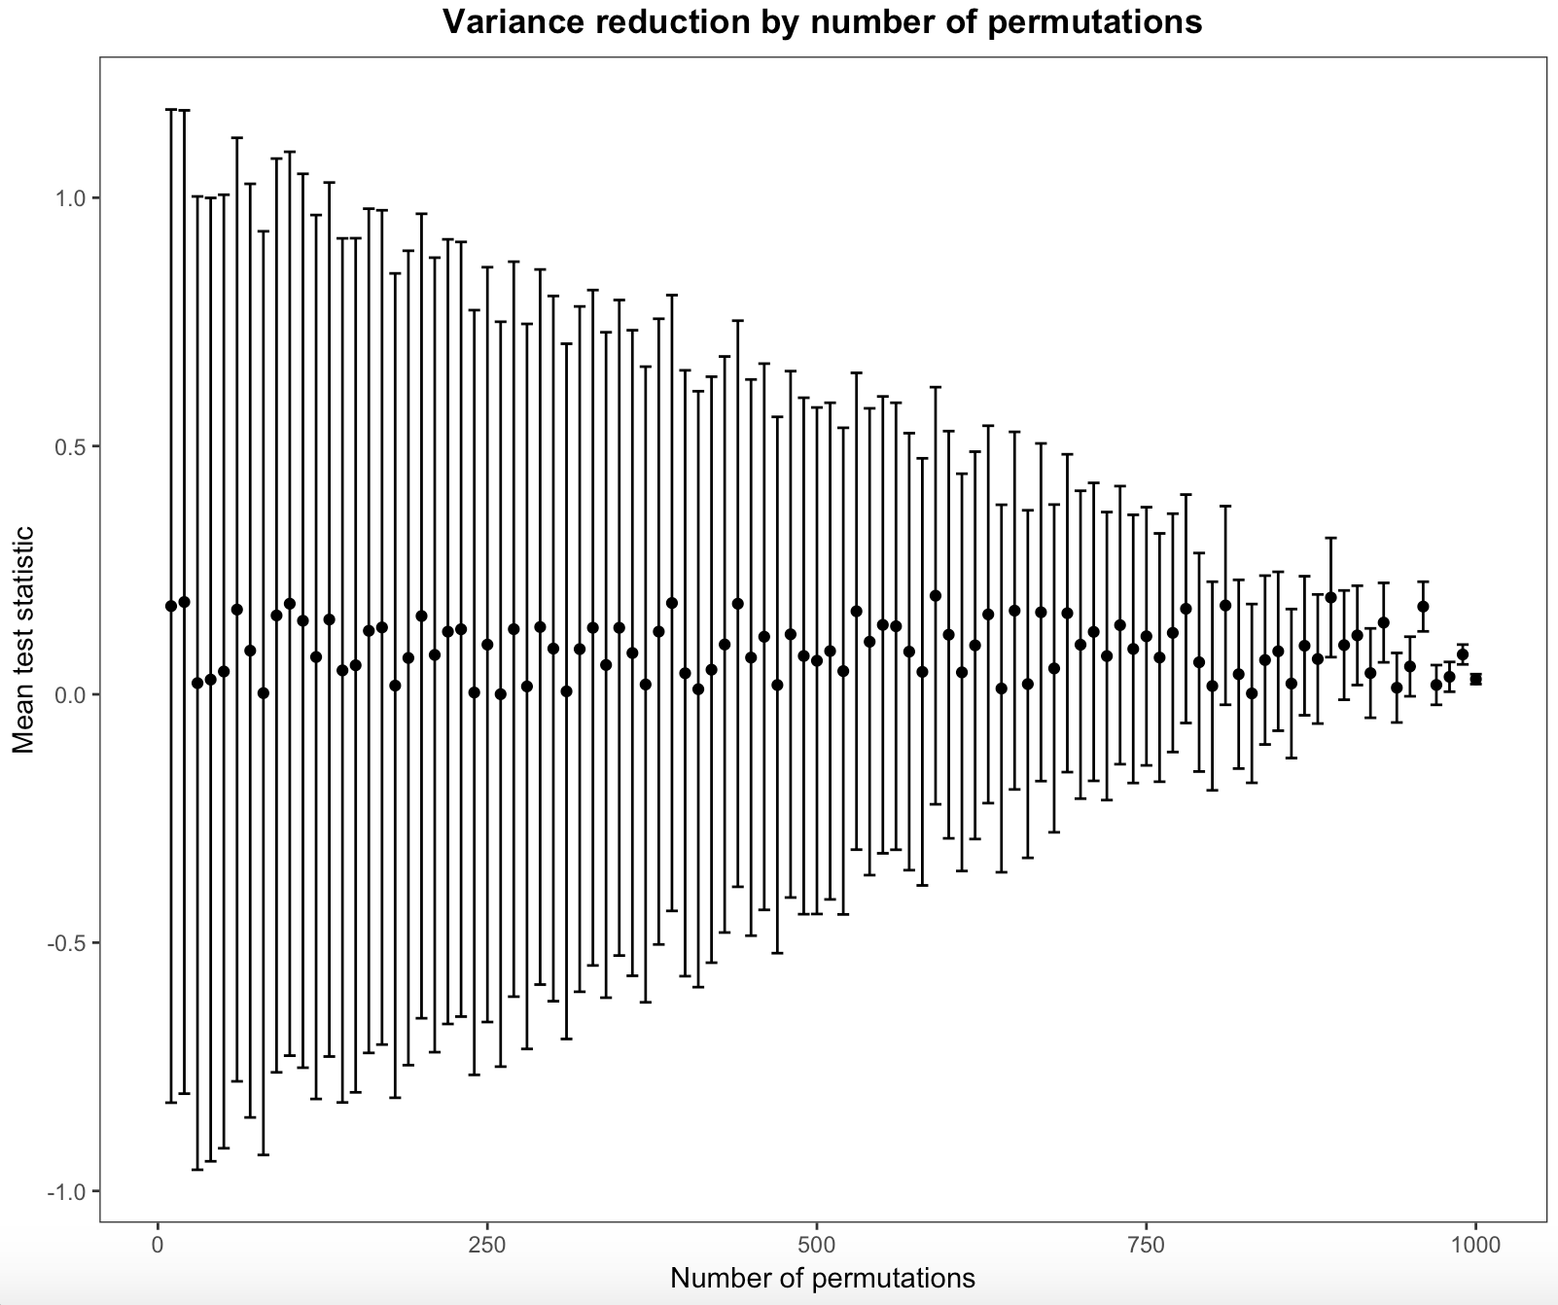
Some Monte Carlo topic
Munch, J., Meyer-Grant, C., Höft, N.
Statistics M. Sc. - Joint masters program
Free University Berlin, Berlin, Germany
Humboldt University Berlin, Berlin, Germany
1. Theory
2. Methods
Permutation tests are nonparametric resampling-based tests, where samples are drawn without replacement unlike in bootstrapping (Rizzo, 2008)
One of various applications (see Good, 2000) is the Kolmogorov-Smirnoff permutation test (KSP test)
Since many statistical methods require assumptions about the distibutions that the sample was drawn from, the Kolmogorov-Smirnoff test (KS test) can be used to test the sample distribution against a theoretical distribution
When two emprical distibutions are tested against each other, the KS test becomes invalid since the distribution under H0 is no longer a KS distribution but unknown (Praestgaard, 1995)
This problem can be overcome by using the KSP test of the hypothesis H0 :F =G vs H1 :F ̸=G
Under H0: F and G are both samples from the same distribution
The test creates random permutations of the samples
The resulting distribution of the KS test statistic is used to compute an empirical p-value
This p-value is exact when all N!/n!*m! permutations are considered, otherwise a subset of k permutations can be used to approximate this p-value
WHAT DID WE TRY TO FIND OUT IN OUR SIMULATION?
N = 1000 random samples were drawn from a standard normal distribution and split up into two equally large groups
The observed KS test statistic is the maximal distance between the emprirical cumulative distribution functions
Number of permutations (k) from 10 to XXX in steps of 10
The calculation of the empirical p-value (fraction of test statistics that exceed the originally observed test statistic) for each value of k was repeated XXX times
Means and the variances of the empirical p-values were computed
Since these p-values are i.i.d., by central limit theorem, normality can be assumed for the calculation of confidence intervals
SAMPLE SIZE PART
3. Results
Figure 1. ECDFs and KS test statistic
Figure 2. Histogram of simulated KS test statistics and empirical 95% quantile
Figure 3. Density estimation for the empirical p-values for four different number of permutations
Figure 4. Mean and 95%-CI of empirical p-values for different numbers of permutations
Discussion
In cases where it is of greater interest whether two samples are identically distributed (e.g. normally) rather than if they come from the same distribution, standardization can be applied
In applications where the distribution of the tales is of great interest (e.g. risk calculations in fincance), the KSP test may be no sufficiently sensitive
Power of test with increasing sample size? → Werden geringste Unterschiede in den ecdf irgendwann signifikant bzw. ist das relevant? → Kommt auf Anwendung an
References:

